Slide 1
KRSBI
Maladi

Slide 2



PROGRES
Transfer Ilmu
Belajar
Eksekusi

Slide 3
TRANSFER ILMU
Raspberry pi / laptop?
Color Based Tracking Python+Opencv
Machine Learning
Indoor Localization

Slide 4
TRANSFER ILMU
laptop
Kecepatan
Setting
Referensi tim lain
Notes:
Multi Processing

Slide 5
TRANSFER ILMU
Color Based Tracking Python+Opencv
Python = Support opencv, ringan, mudah, banyak referensi
Tracking Bola
Kesulitan untuk gawang
Mengenali kawan dan lawan

Slide 6
TRANSFER ILMU
Machine Learning
Solusi Gawang
Tensorflow
Yolo

Slide 7
TRANSFER ILMU
INDOOR LOCALIZATION
Tahun lalu belum bisa
Pozxy(Tidak sesuai dengan rule)

Slide 8
BELAJAR

Slide 9
Belajar
Omnivision
Odometry, optical odometry, visual odometry
Yolo

Slide 10
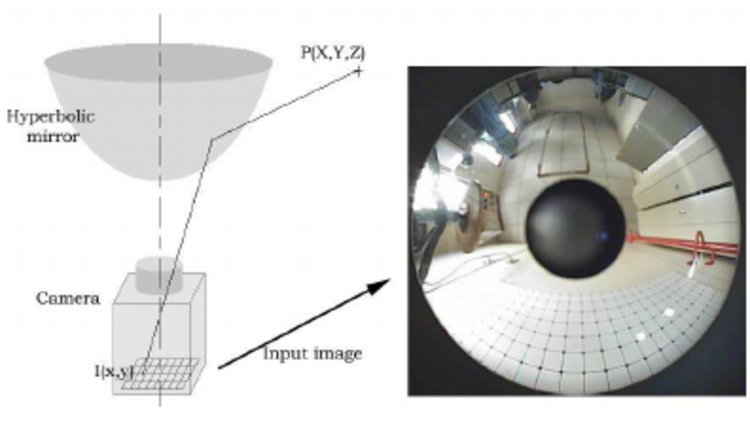
OMNIVISION

Slide 11
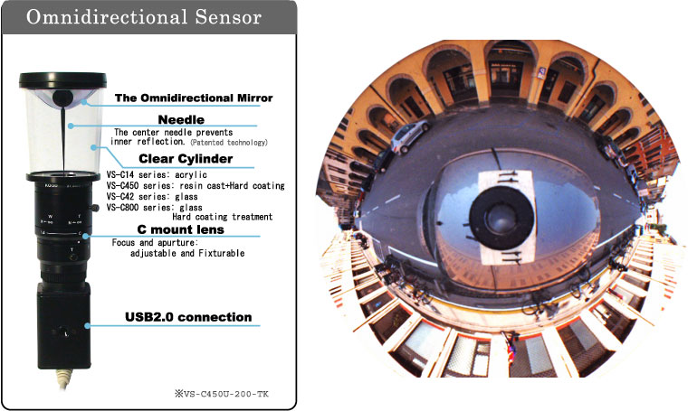
OMNIVISION
Notes:
KABAR BAIK, BURUK

Slide 12
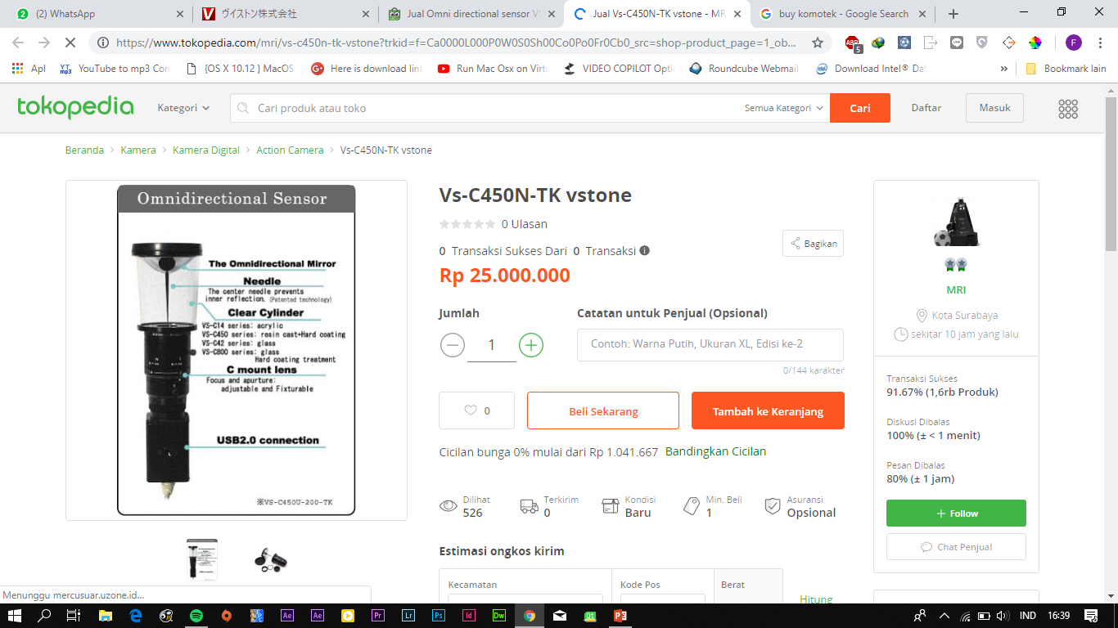
OMNIVISION

Slide 13
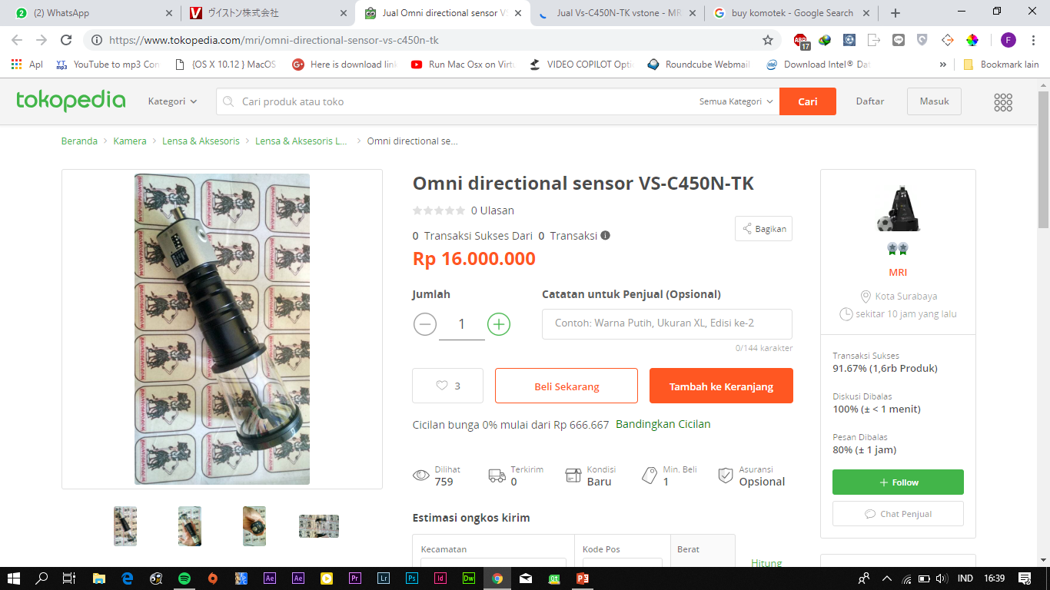
OMNIVISION

Slide 14
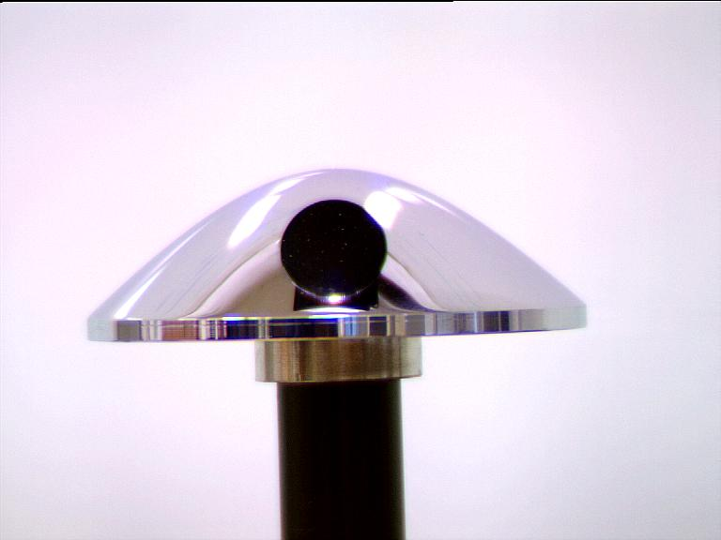
OMNIVISION

Slide 15
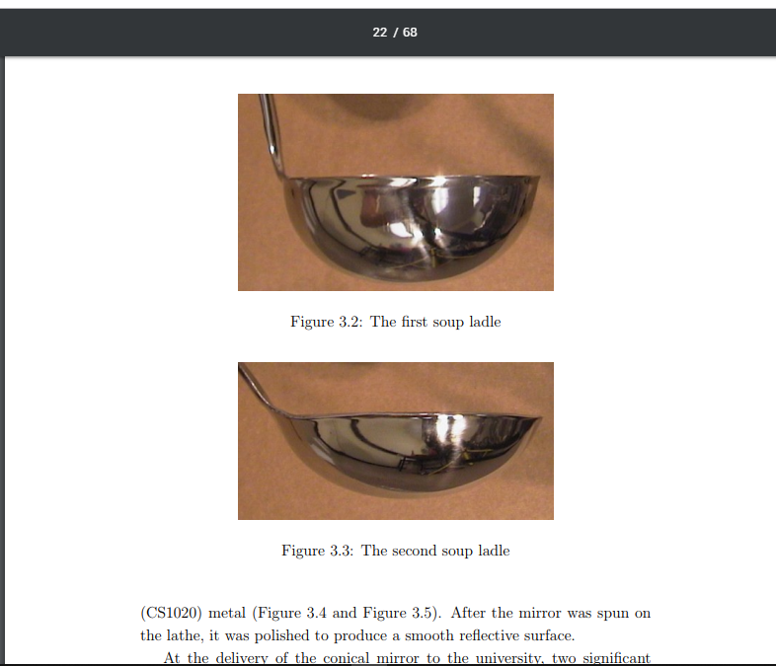
OMNIVISION

Slide 16
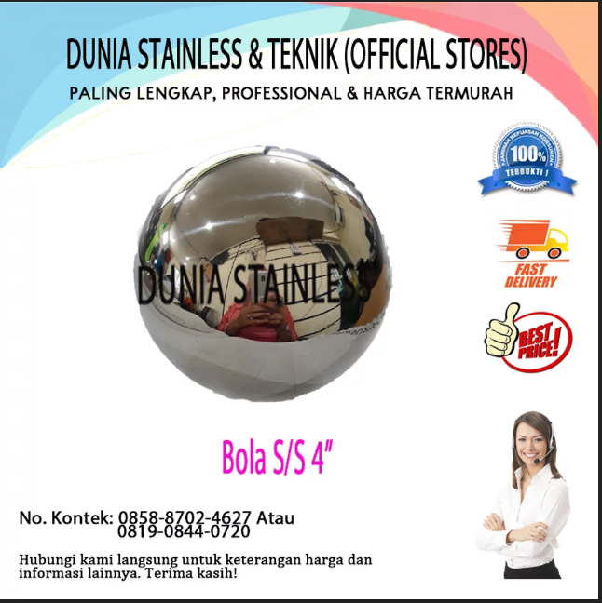
OMNIVISION

Slide 17
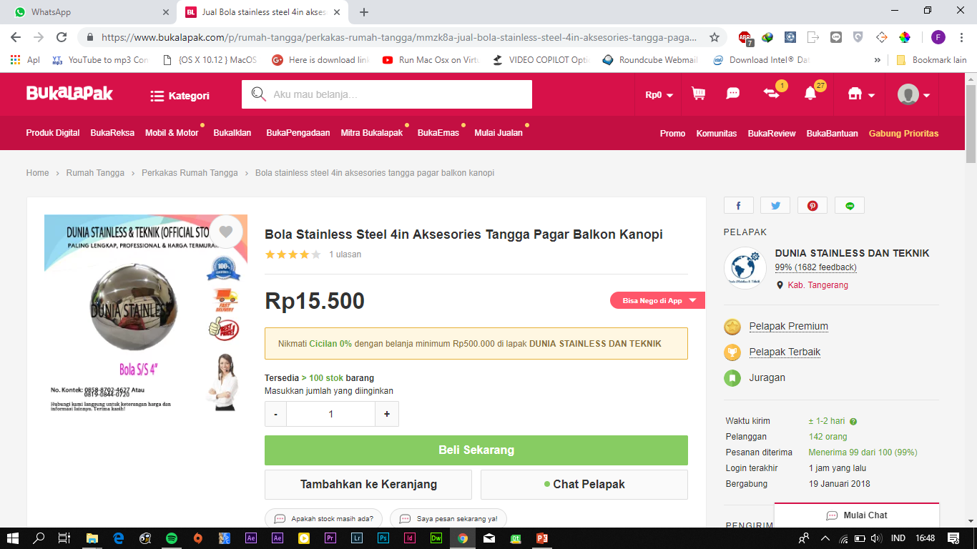
OMNIVISION

Slide 18
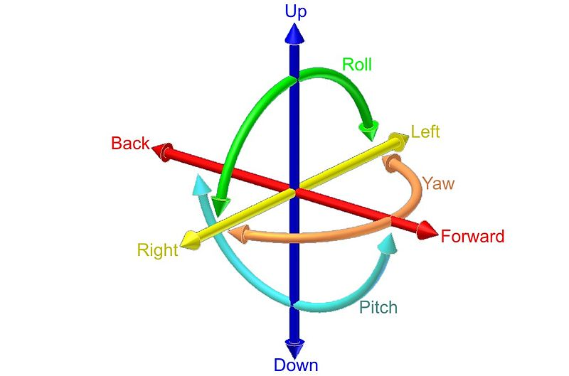
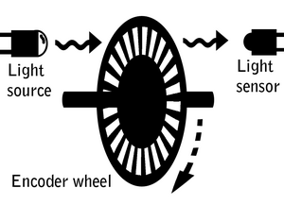

ODOMETRY
Odometry is the use of data from motion sensors to estimate change in position over time.
COMPASS
IMU
ENCODER
Notes:
Kalman Filter

Slide 19
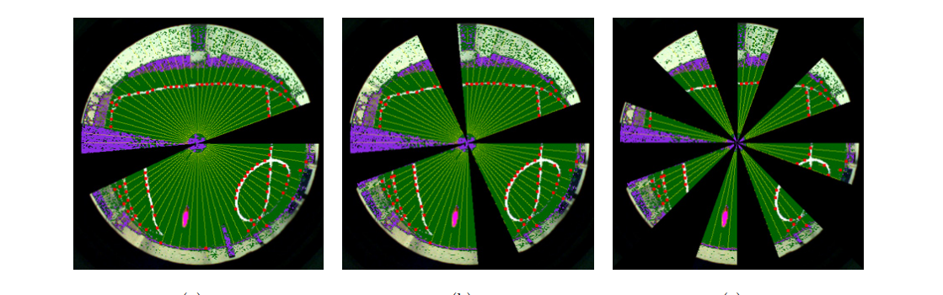
ODOMETRY
Visual Odometry
Odometry dengan menggunakan vision sensor

Slide 20
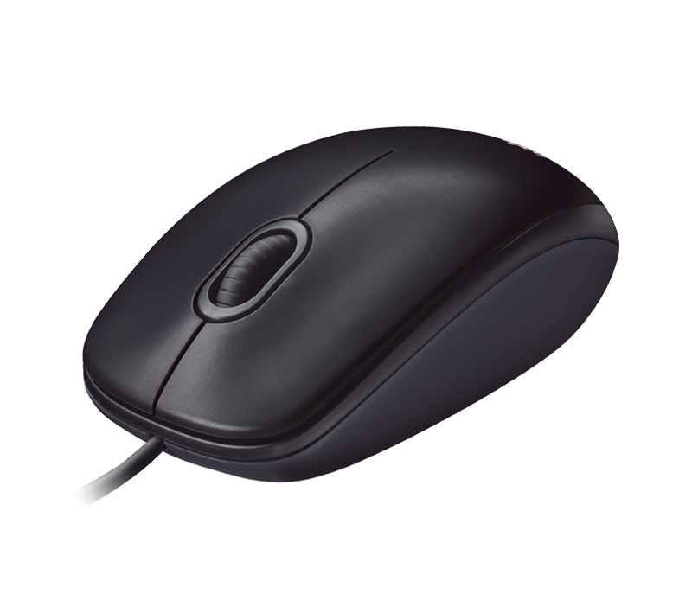
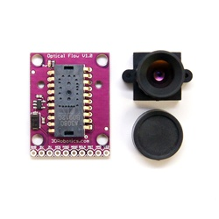
ODOMETRY
Optical Odometry
Odometry dengan menggunakan optical sensor
ADNS3080
Notes:
Gimbal

Slide 21

You Only Look Once
Real-time object detection system

Slide 22
EKSEKUSI

Slide 23
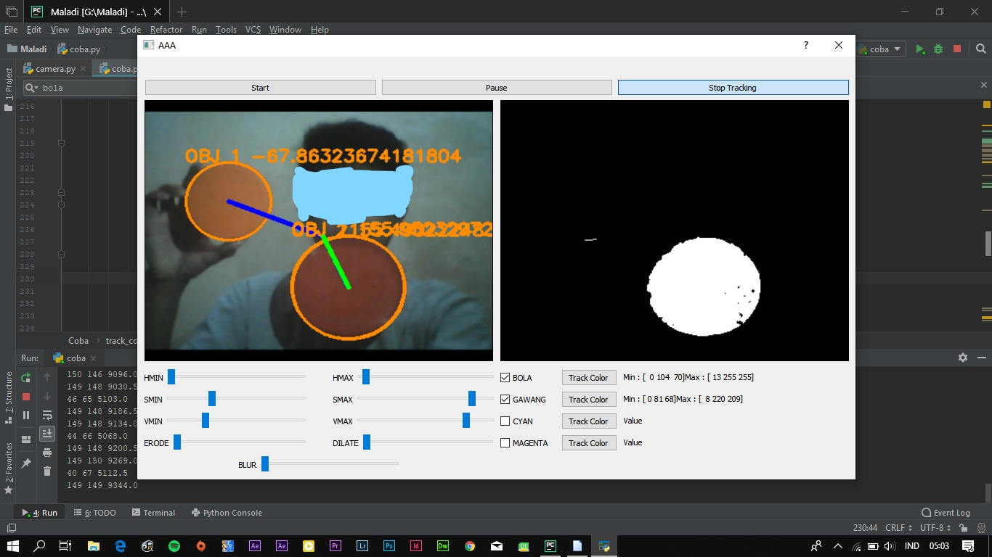
Color Based Tracking Python+Opencv

Slide 24
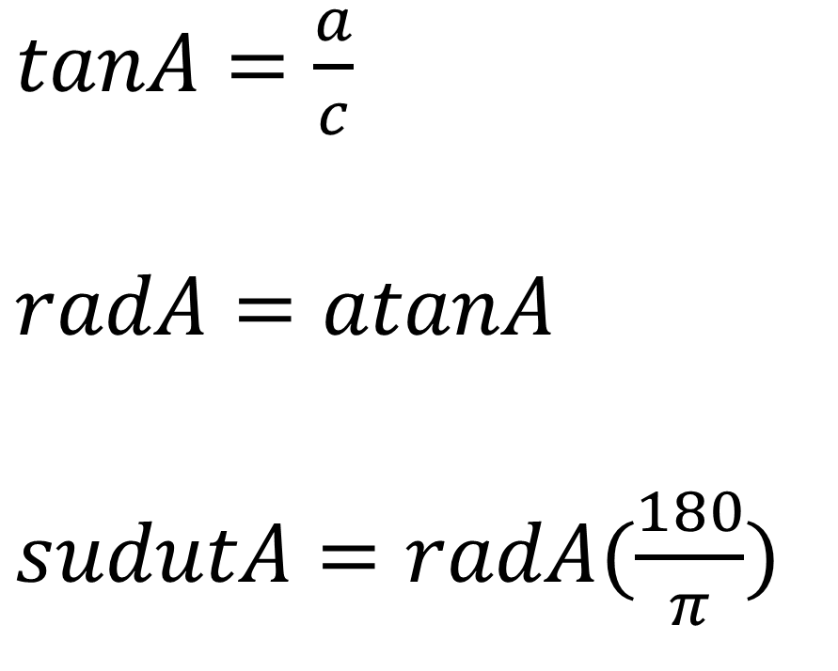
Color Based Tracking Python+Opencv
B
a
C
$tanA=\frac{a}{c}$
$radA=atanA$
$sudutA=radA(\frac{180}{π})$
c
b
A

Slide 25
Color Based Tracking Python+Opencv
B = hadap depan
C = bola
a
c
b
A = titik tengah camera

Slide 26
Color Based Tracking Python+Opencv
B = hadap depan
a
C = bola
c
b
A = titik tengah camera
$$jarak 2 titik= \sqrt{{(x2−x1)}^{2}+{(y2−y1)}^{2}}$$

Slide 27
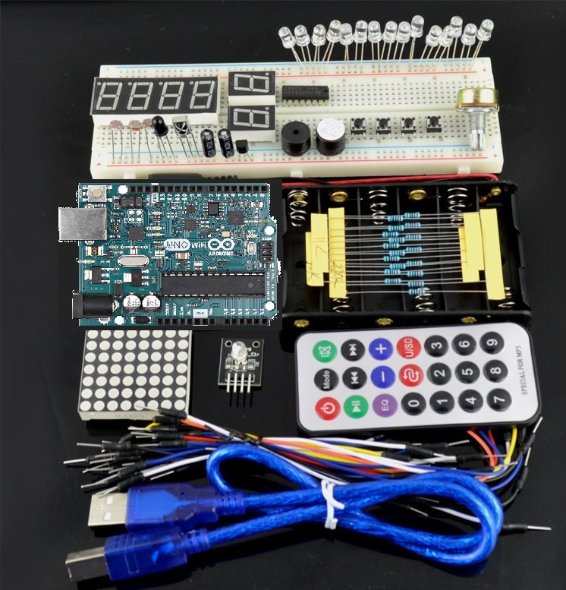
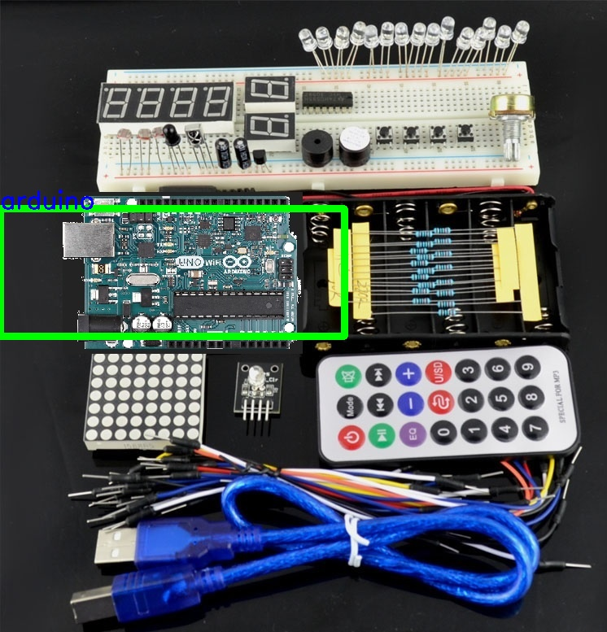
YOLO

Slide 28
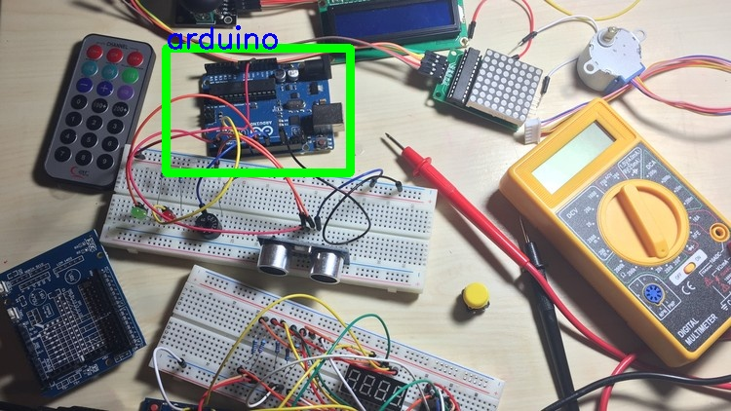
YOLO

Slide 29
FLOWCHART
START
Ball handling
Putar
Deteksi bola & lawan
Posisi gawang
Kiper tengah?
N
Bola?
N
Kejar
Dekat gawang
Y
Y
Kejar
Gawang besar?
Tendang
US bola
Bola dekat?
Posisi kiper
N
Y
END

Slide 30
COLOR SEGMENTATION
START
Omnivision
Masking
Sudut terhadap robot
Bilateral blur
Erosi & Dilasi
Pid
Kirim PID ke arduino
Convert HSV
Find Contour
END

Slide 31
DETEKSI GAWANG
START
Heading
Yolo
N
Heading benar?
Sudut Gawang
Putar
Y
Kamera Depan
PID Gawang
END

Slide 32
KRSBI
Maladi

